Slide 1
Socio-cultural-historical aspects of
Enggano linguistic variations: a preliminary observation

Slide 2
Outline
Enggano: a socio-cultural-historical overview
Enggano Linguistic variations
  Historical and inter-generational variations
  Geographical/horizontal variations
  Social variations and contact phenomena
Methodology and data
Domains/levels of variations
  Lexical
  Phonetic
  Grammatical
Final remarks

Slide 3
Enggano: a socio-cultural-historical overview traditional social structure
Clan grouping: Indigenous vs. non-indigenous clans
  Kauno
  Kaitora
  Kaharuba
  Kaharubi
  Kaahua
  Kamay
Traditional vs. modern leadership
  Pabbuki: the speaker/leader of all clans
  Iur Ahao (kepala suku/adat): Clan head/elder
  Pintu suku: sub-clan leader elder
Notes:
Kauno, Kaitora, Kaharuba, Kaharubi dan Kaahua,

Slide 4
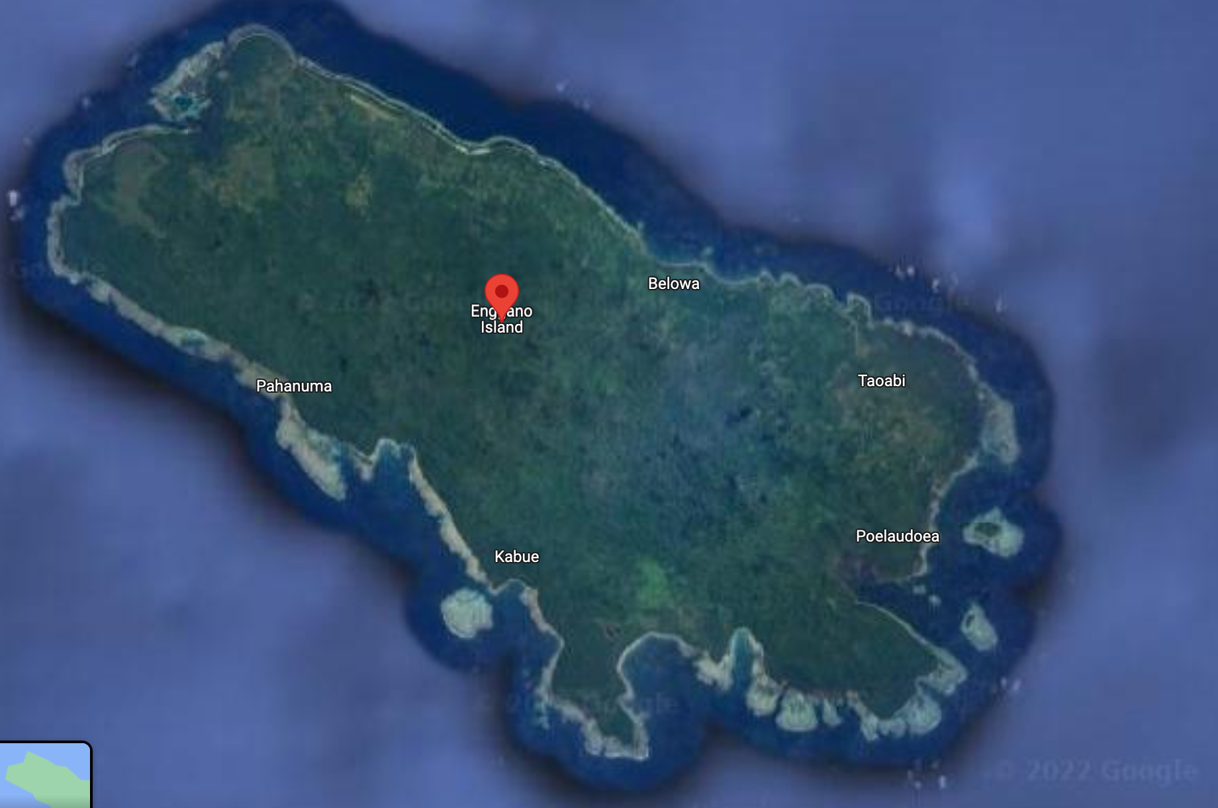
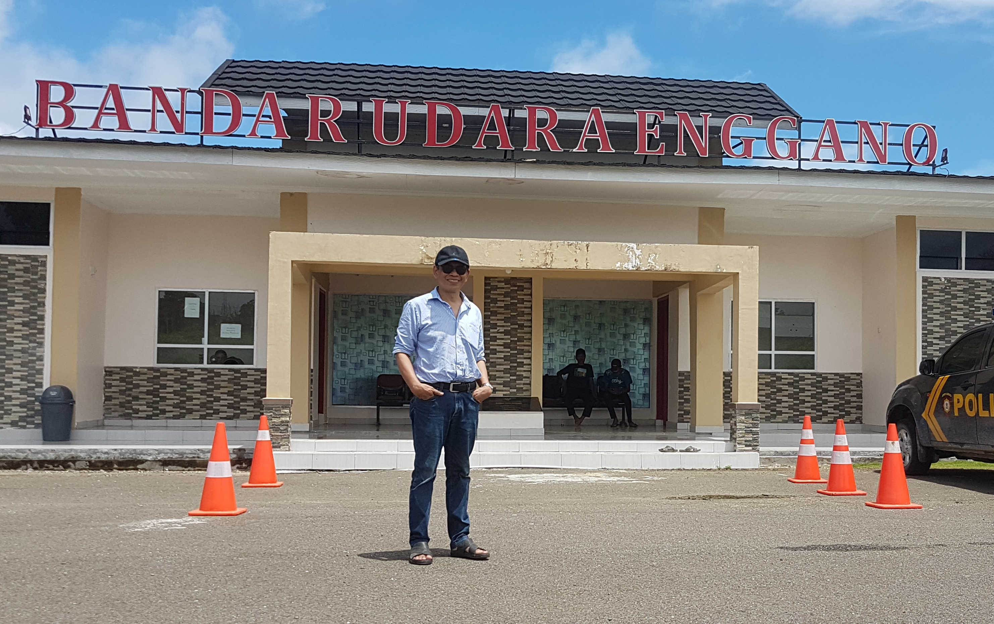
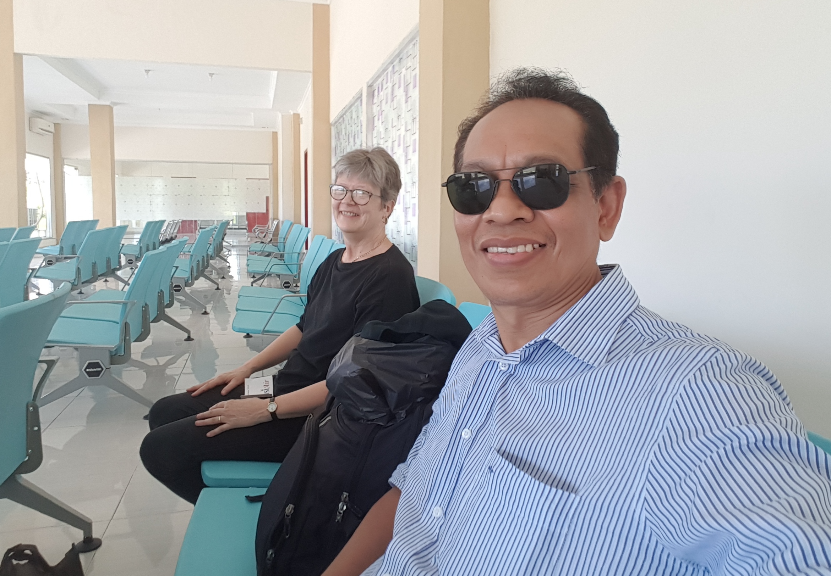
Enggano: a socio-cultural-historical overview
Migration and language contact
The 18th Century or earlier:
not recorded by local (oral) histories
According Johansen (Kaitora Clan elder): 1902, Christianity introduced to Enggano with the first Church in Kahyapu, called Gereja HKBP( Huria Kristen batak protestan), built on the Island of Dua.
Sea ports:
  First Enggano port was in Pulau Dua
  Then, the Enggano port in Malakoni
  The more recent port in Kahyapu
Enggano Airport in Banjarsari

Slide 5
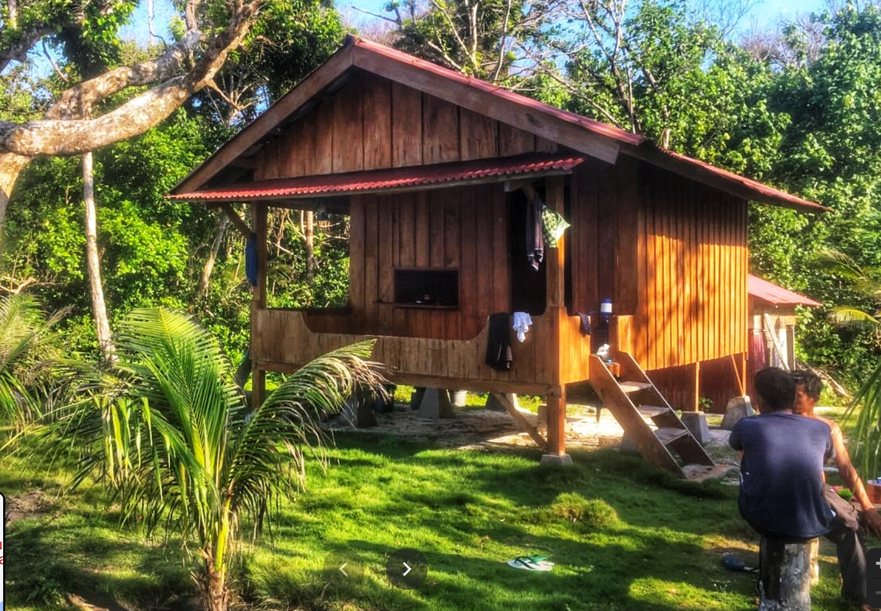
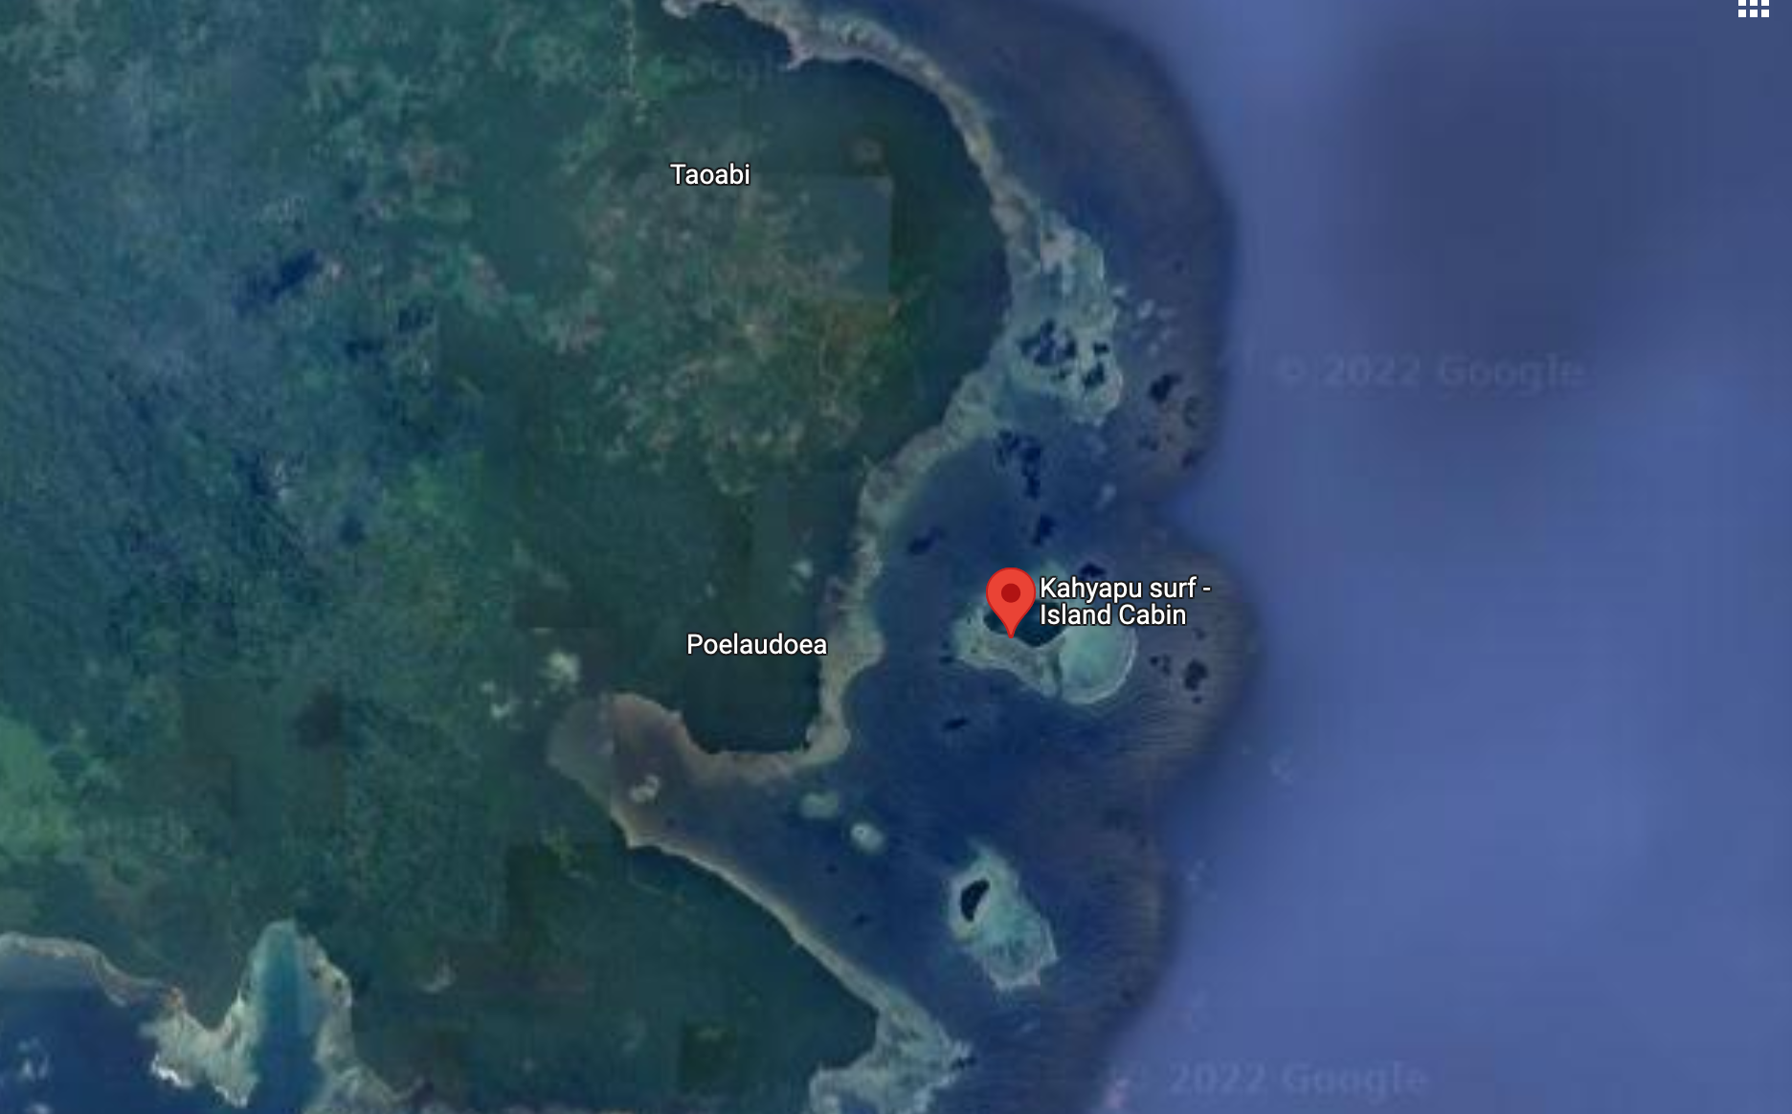
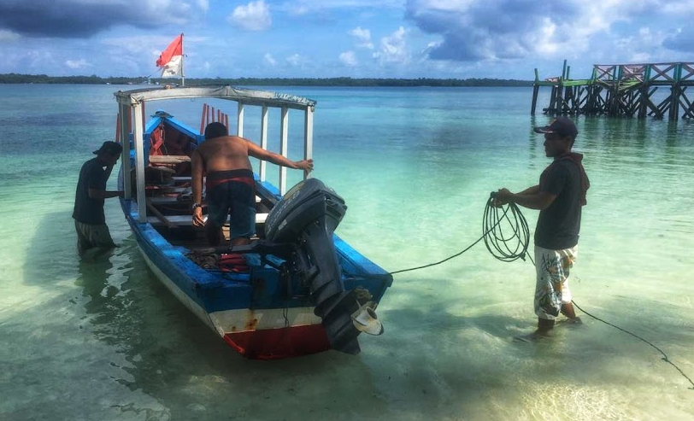
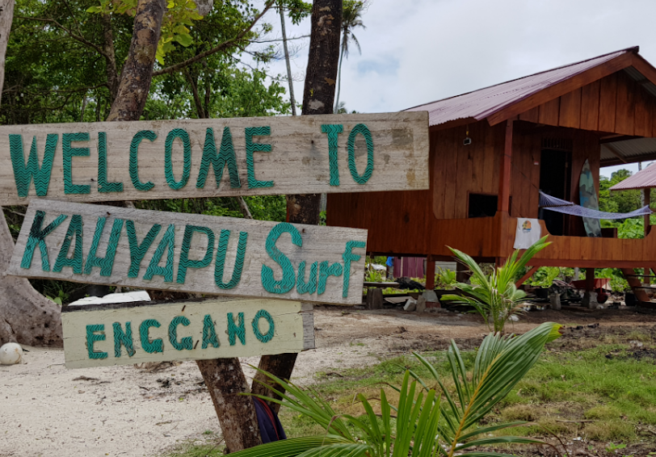
Pulau Dua (now) …

Slide 6
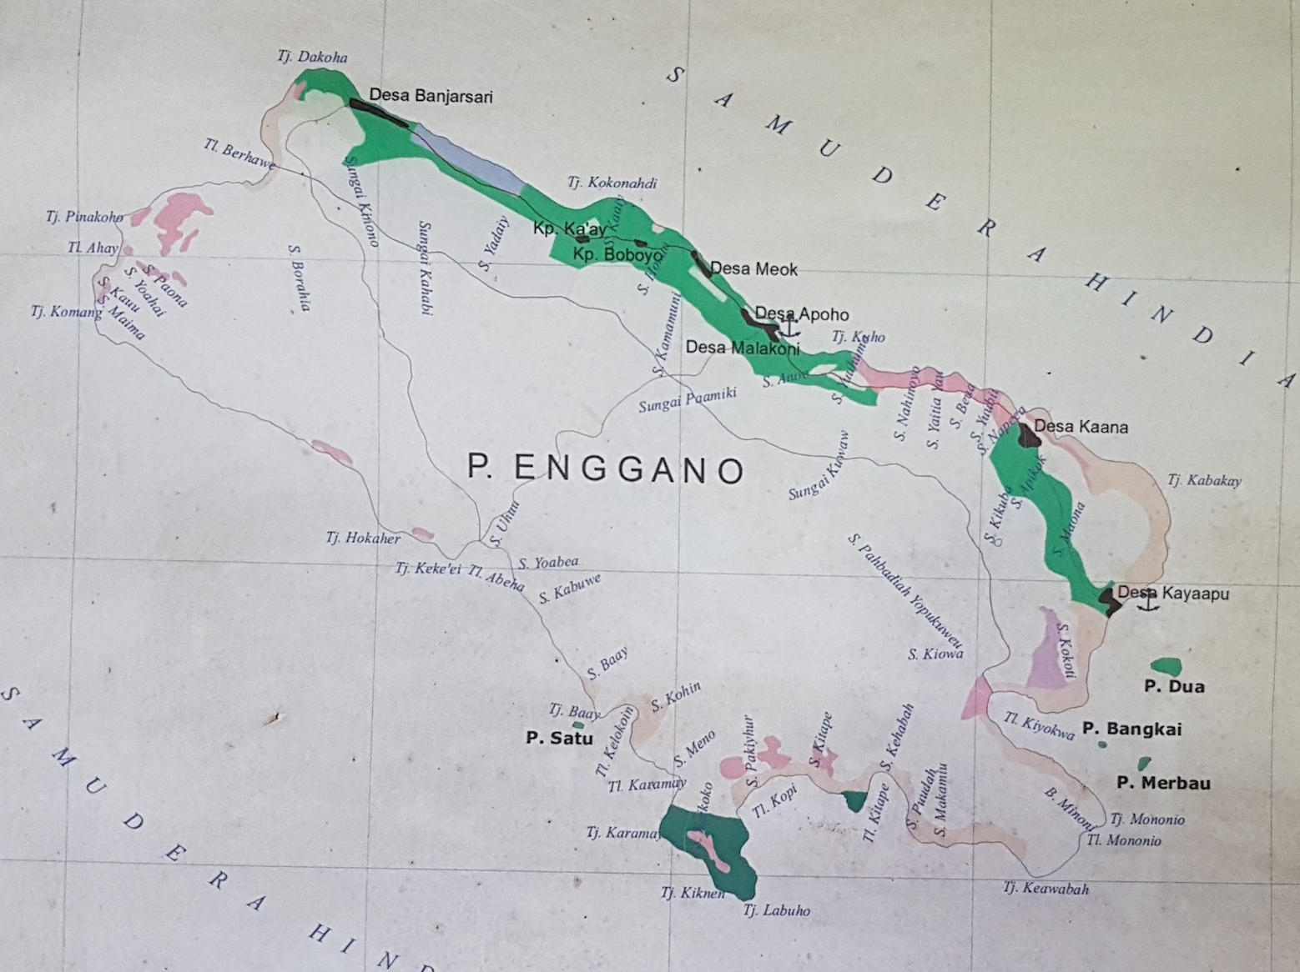
Contemporary Enggano: social networks and migrants
Three main areas with the central area consisting of Meok, Apoho and Malankoli being the conservative villages where native fluent speakers generally live.
Non-Enggano migrants typically live in the northern and southern villages of Banjarsari, Kaana and Kahyapu:
outnumbering the local Enggano people
Recent infrastructure development: better/additional seaports, better roads connecting the villages, more mobility
  Disturbing and changing the traditional ecologies and social networks
  → accelerated language shift to Indonesian
Notes:
Size of the island,

Slide 7
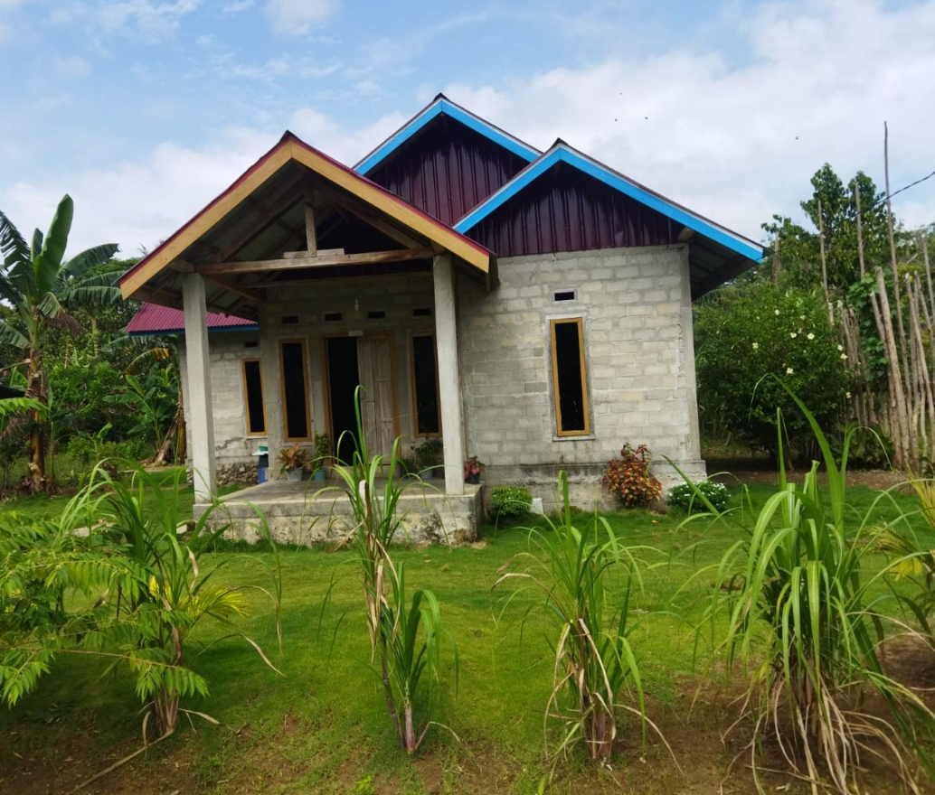
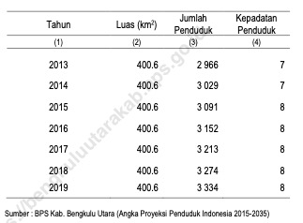
Enggano: a socio-cultural-historical overview
Demography
Population (based on the BPS statistics)

Slide 8
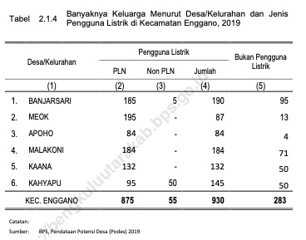
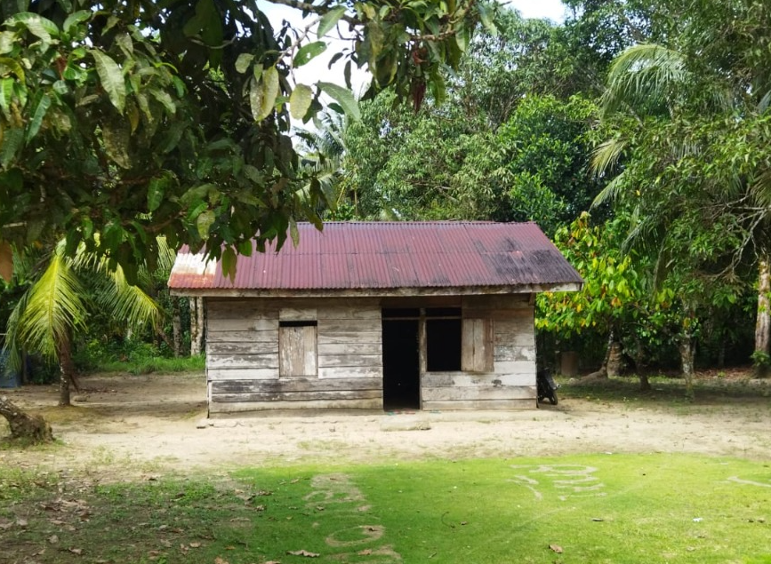
Demography
KK (family units) dominated by non-Enggano villages of Banjarsari, Kaana and Kahyapu
Banjarsari: 285 families (or 23.5% of total number of families in Enggano)
Notes:
Banjarsari: 190+95= 285
Total: 930+283=

Slide 9
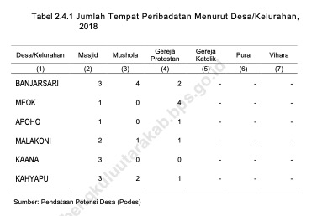
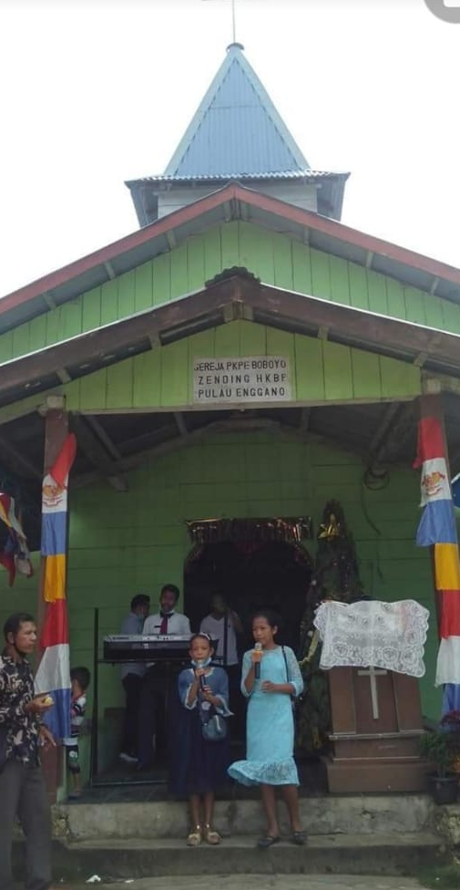
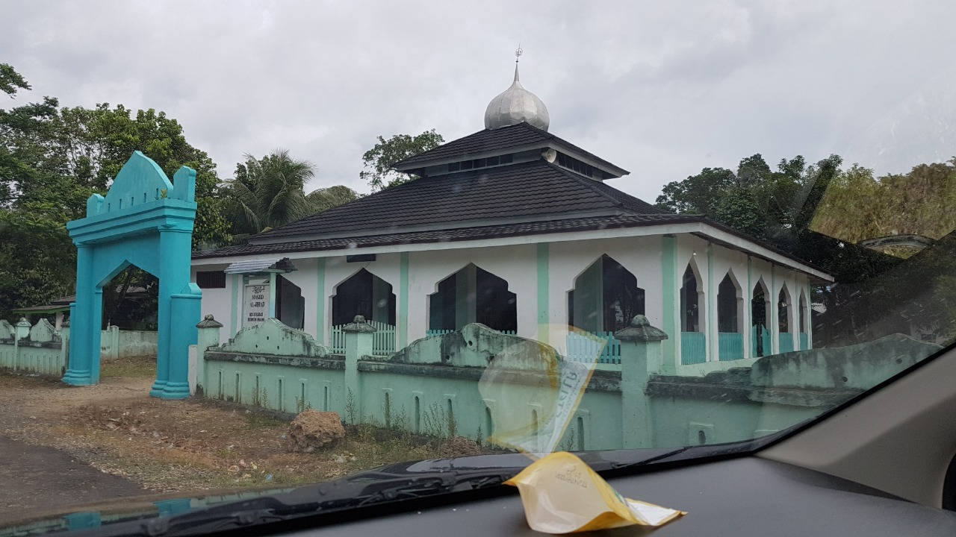
Religion
Moslems: mosques/
musholas
  Banjarsari (7)
  Meok (1)
  Apoho (1)
  Malakoni (3)
  Kaana (3)
  Kahyapu (5)
Christians, Churches
  Banjarsari (2)
  Meok (4)
  Apoho (1)
  Malakoni (1)
  Kaana (0)
  Kahyapu (1)
Notes:
Christianity first
Islam, only recently.

Slide 10
Enggano linguistic variations

Slide 11
Methodology & data
Multiple methods
Swadesh list: lexical and phonetic variations
Subjective reporting (by language consultants)
Ethnography
Enggano corpus: natural language use

Slide 12
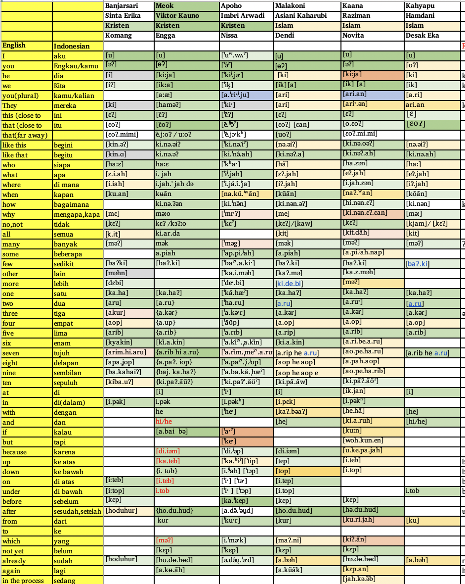
Lexical and phonetic variations: an overview
Overlapping, no clear converging isoglosses for each item:
limited data
Tentatively ‘three’ dialectal variations on the basis of clustering of (dis)similar lexical and phonetic variations
Northern Enggano: Banjarsari
Central Enggano:
Meok-Apoho
Southern Enggano:
Melakoni-Kaana-Kahyapu

Slide 13
Lexical and phonetic variations
Overlapping, no clear converging isoglosses for each item:
limited data
Lexical item: ‘already’ (PAN/PMP *na)
Northern Enggano: Banjarsari : [hoduhur]
Central Enggano:
Meok-Apoho : [hʊdʉhʉd]
Southern Enggano:
Melakoni : [abəh]
Kaana : [hədʉhʉd]
Kahyapu : [abəh]
Notes:
ho = sudah (<*na)
dʉhʉr = selesai
[hoduhur] [hʊ.dʉ.hʉd] [ə.də̆u̯.ˈəˑd] [a.bəh] [hə.dʉ.hʉd] [a.bəh]

Slide 14

Lexical and phonetic variations
Lexical item: ‘mother’ (PAN/PWMP *ina)
loan words in Kaana and Kahyapu varieties
Northern Enggano: Banjarsari : [nan]
Central Enggano:
Meok-Apoho : [naj]
Southern Enggano:
Melakoni : [ɛ.na]
Kaana : [ə.mak.ɛʰ]
Kahyapu : [ə.mak]
Notes:
[næn] [naj] [ˈnaʲ] [ɛ.na] [ə.mak.neʰ] [ə.mak]

Slide 15
Lexical and phonetic variations
Lexical item: ‘morning’ & ‘flower’
[p]/[b] ~ [m] alternation; monophthong/diphthong quality
‘morning’ ‘flower’
(PMP *siaŋ) (PAN *buŋa; PMP *buŋaŋ)
Northern Enggano: Banjarsari : [poh.mãn] [mũˈo:]
Central Enggano:
Meok : [paʊh.mãn] [mũːo]
Apoho : [paʰ.o.mãn] [bŭ.ˈŋoˑ]
Southern Enggano:
Melakoni : [poh.mãn] [mũ.õ]
Kaana : [ma.u.mãn] [bũ.ŋõ]
Kahyapu : [paʰ.mãn] [mũ.ŋɔ]
Notes:
[poh.man] [paʊh.man] [ˈpaʰ.o.mãn] [poh.man] [ma.u.man] [paʰ.man]
[mu'o:] [mũːo] [bŭ.ˈŋoˑ] [mũ.õ] [bu.ŋõ] [m̃u.ŋɔ]
*siaŋ daylight; morning sunshine

Slide 16
Lexical and phonetic variations
Lexical item: ‘stone’
Kaana is distinct from the other varieties:
‘stone’
(PMP *batu)
Northern Enggano: Banjarsari : [ɪ:]
Central Enggano:
Meok : [e.i]
Apoho : [i.jə]
Southern Enggano:
Melakoni : [e.i]
Kaana : [pa.kaʔ.ao]
Kahyapu : [i.je]
Notes:
[ɪ:] [e.i] [ˈi.jəˑ] [e.i] [pa.kaʔ.ao] [i.je]

Slide 17
Lexical and phonetic variations
Lexical item: ‘dry’
Nasal and non-nasal variations
‘dry’
(PAN *waRi; PWMP *kaRiŋ/*keRiŋ)
Northern Enggano: Banjarsari : [ka'ki:h]
Central Enggano:
Meok/ : [kaʔ.ki]
Apoho :
Southern Enggano
Melakoni : [kaʔ.ki]
Kaana : [kaʔ.a.kih]
Kahyapu : [ŋãʔ.ŋĩh]
Notes:
[ka'ki:h] [kaʔ.ki] [kaʔ.ki] [kaʔ.a.kih] [ŋɑʔ.ŋih]

Slide 18
Generational grammatical variations:
Intergenerational variation in morpho-syntax: possessive expressions

Slide 19
Prosody and grammatical variations
The Southern Enggano variety is typically characterised
  by a higher degree of Indonesian code switching than the Central Enggano variety;
  the presence of certain particles like he
  distinct sentential prosody
Notes:
hale (Malakoni, archaic) ‘jaman dulu’ Vs kahinu̇ (contemporary Enggano)ː dulu
pakno (Meok, Archaic)) ‘memberi/ijinan’ vs kipe ‘memberi, pe ‘beri’ (contemporary Enggano)
pahoro (Meok, Archaic) ‘salah’ vs karah ‘salah’ (contemporary Enggao) vs. koro ‘damai’
Iabah (Archaic, by Victor) ː kelaparan vs kõ (contemporary Enggano) ‘lapar’
Aiam (Meok and others) Vs kiadem (Kaana)

Slide 20
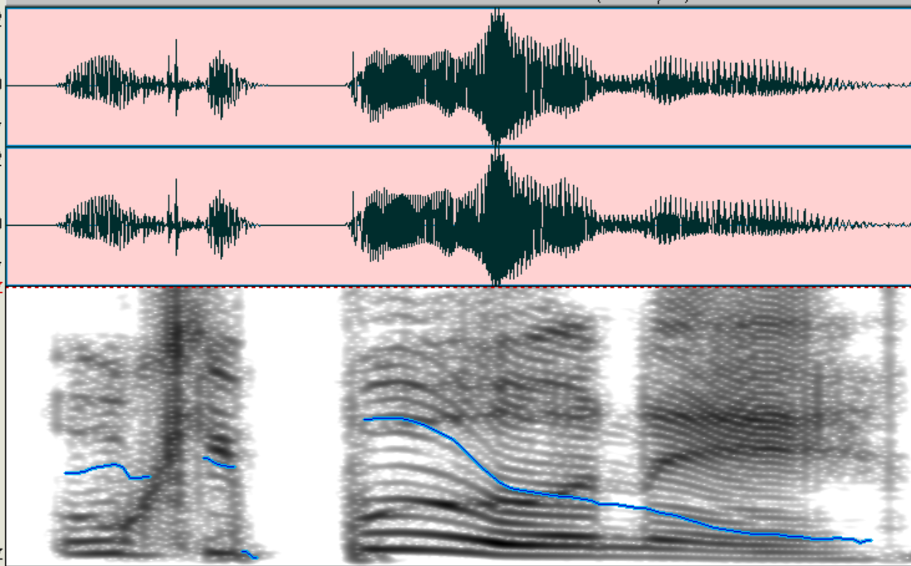
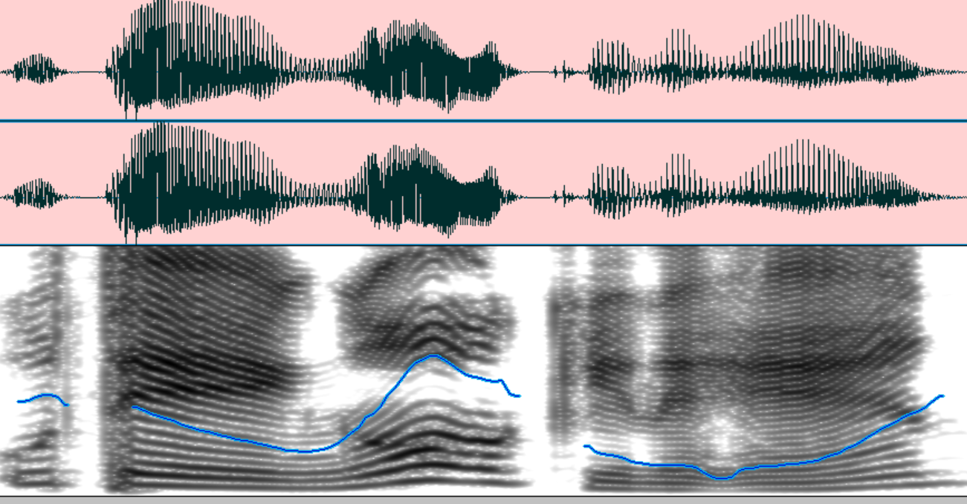
Prosody and grammatical variations
Northern Enggano:
Banjarsari
Central Enggano:
Meok-Apoho : u kipu̇ ė’ ne’en
‘I saw you jut now.’
Southern Enggano:
Melakoni :
Kaana : ė’ tengok ki na’an
‘I saw you just now’
Kahyapu :
Notes:
hale (Malakoni, archaic) ‘jaman dulu’ Vs kahinu̇ (contemporary Enggano)ː dulu
pakno (Meok, Archaic)) ‘memberi/ijinan’ vs kipe ‘memberi, pe ‘beri’ (contemporary Enggano)
pahoro (Meok, Archaic) ‘salah’ vs karah ‘salah’ (contemporary Enggao) vs. koro ‘damai’
Iabah (Archaic, by Victor) ː kelaparan vs kõ (contemporary Enggano) ‘lapar’
Aiam (Meok and others) Vs kiadem (Kaana)

Slide 21
Prosodic and grammatical variations
Northern Enggano: Banjarsari
Central Enggano:
Meok-Apoho : ė’ kur ĩãh
2 from where
‘where are you from?’
Southern Enggano:
Melakoni :
Kaana : he ė’ dari mana?
PART 2 from where
‘where are you from?’
Kahyapu :
Notes:
hale (Malakoni, archaic) ‘jaman dulu’ Vs kahinu̇ (contemporary Enggano)ː dulu
pakno (Meok, Archaic)) ‘memberi/ijinan’ vs kipe ‘memberi, pe ‘beri’ (contemporary Enggano)
pahoro (Meok, Archaic) ‘salah’ vs karah ‘salah’ (contemporary Enggao) vs. koro ‘damai’
Iabah (Archaic, by Victor) ː kelaparan vs kõ (contemporary Enggano) ‘lapar’
Aiam (Meok and others) Vs kiadem (Kaana)

Slide 22
Prosodic and grammatical variations
Northern Enggano:
Banjarsari
Central Enggano:
Meok-Apoho : Ha mė’ ka ean?
‘who’s that coming?’
Southern Enggano:
Melakoni :
Kaana : Ha mė’ datang ean?
‘who’s that coming?’
Kahyapu :
Notes:
hale (Malakoni, archaic) ‘jaman dulu’ Vs kahinu̇ (contemporary Enggano)ː dulu
pakno (Meok, Archaic)) ‘memberi/ijinan’ vs kipe ‘memberi, pe ‘beri’ (contemporary Enggano)
pahoro (Meok, Archaic) ‘salah’ vs karah ‘salah’ (contemporary Enggao) vs. koro ‘damai’
Iabah (Archaic, by Victor) ː kelaparan vs kõ (contemporary Enggano) ‘lapar’
Aiam (Meok and others) Vs kiadem (Kaana)

Slide 23
DISCUSSION language change
/variation/diversification/endangerment what do we learn from the Enggano case?

Slide 24
Identity and language variation
The significance of religious affiliation/identity and social networks in language diversification/variation
Three dialectal variations on the basis of clustering of (dis)similar lexical and phonetic variations
Northern Enggano: Banjarsari
Central Enggano:
Meok-Apoho
Southern Enggano:
Melakoni-Kaana-Kahyapu

Slide 25
Generational grammatical variations: grammaticalization paths
Intergenerational variation in morpho-syntax: language change in progress
Notes:
(a) simplification: the loss of b~m alternation, sensitive to the derivational morphology (i.e. stem vs. word distinction). Layers in lexical Moprhology. The alternation is sensitive to the knowledge of interna structure of words.
(b) generalisation: the nasal forms are acquired as words and therefore stem (X). The internal structure is opaque.
(b) Syntax to morphology path of gramaticalisation: Givon’s idea of yesterday syntax is today’s morphology.

Slide 26
Further planned investigation …
Variations across villages/social classes/generations
  More representative data
  Acquisition data: children speech
socio-phonetics with solid evidence…
…

